Slide 1
http://ltwiki.org/files/LTspiceIV/lib/sub/

Slide 2
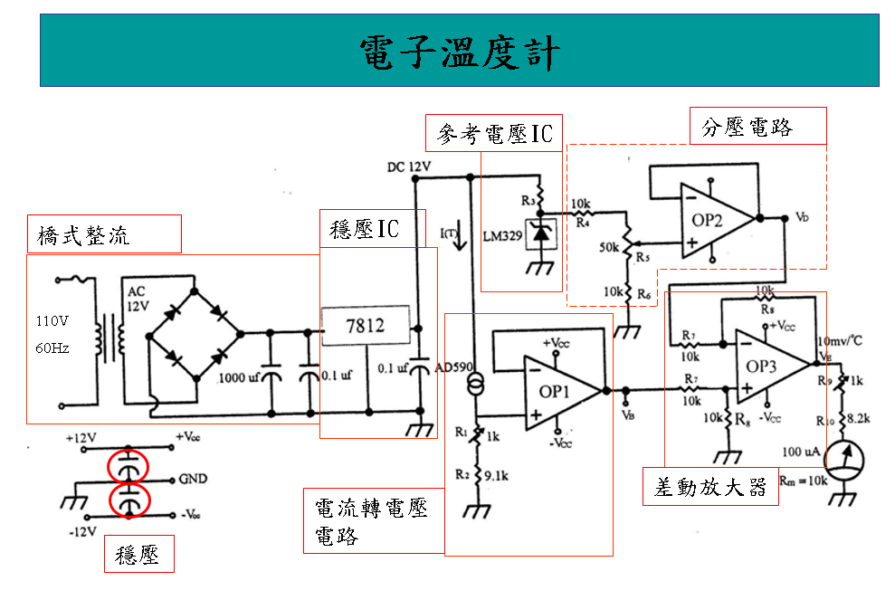
(C)
(B)
(A)

Slide 3
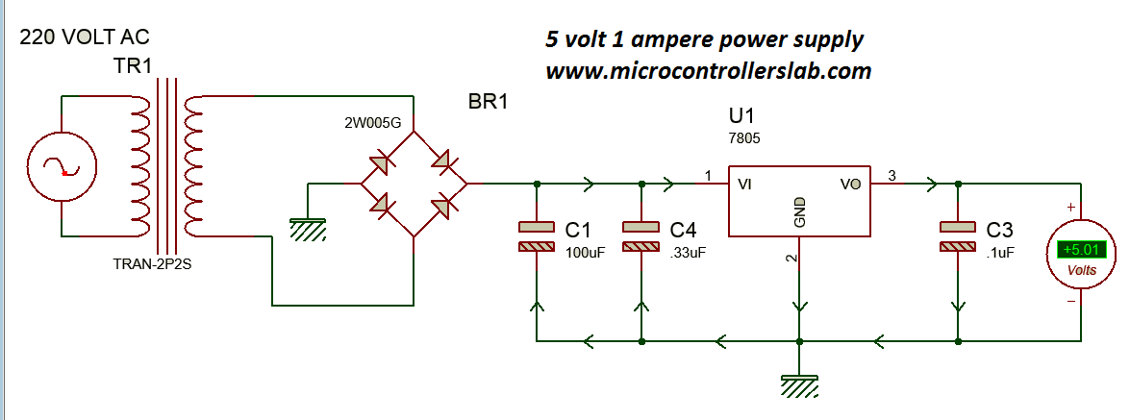
https://microcontrollerslab.com/power-supply-electronics-projects/

Slide 4
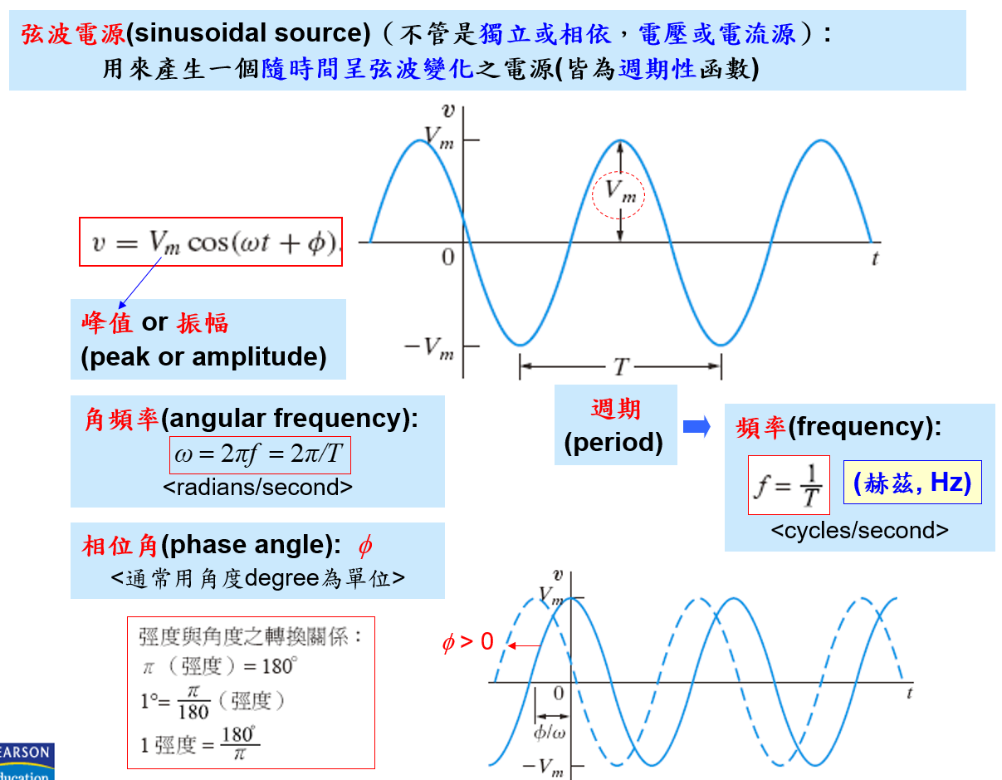

Slide 5
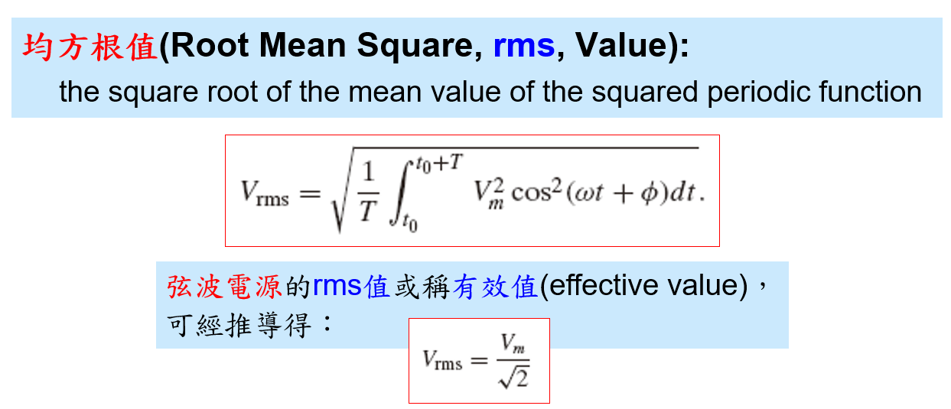
But How!!??

Slide 6
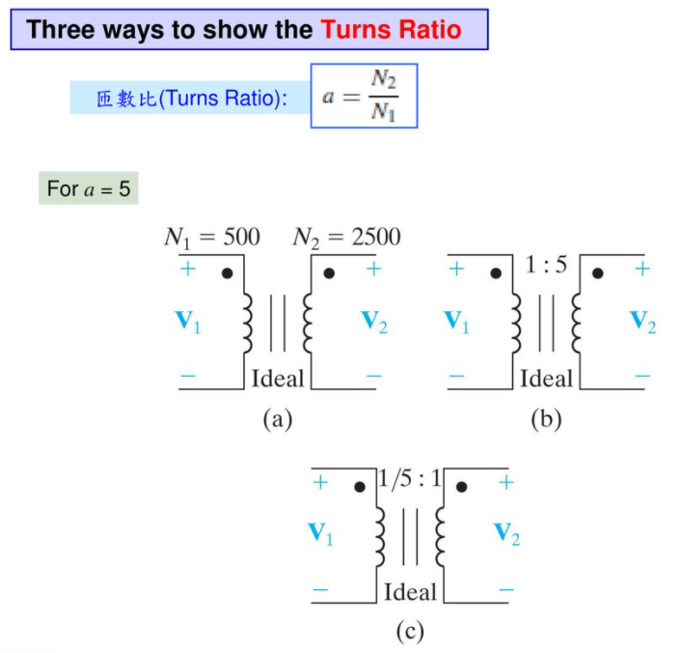

Slide 7
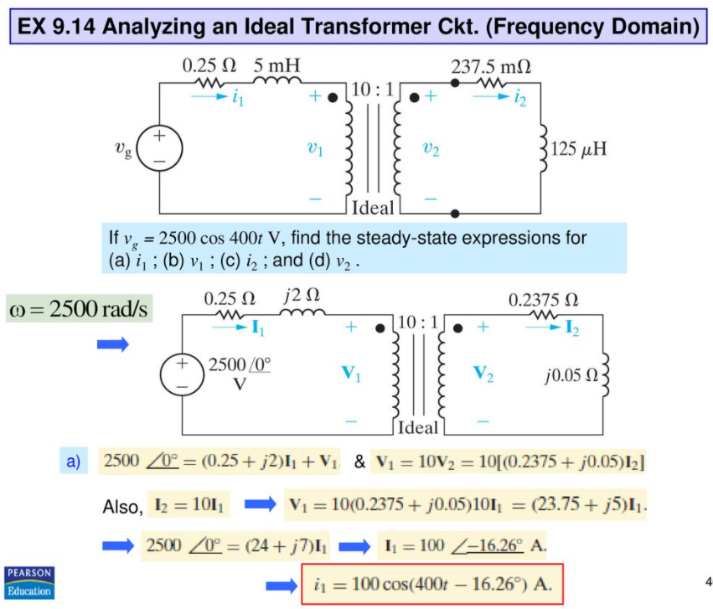

Slide 8
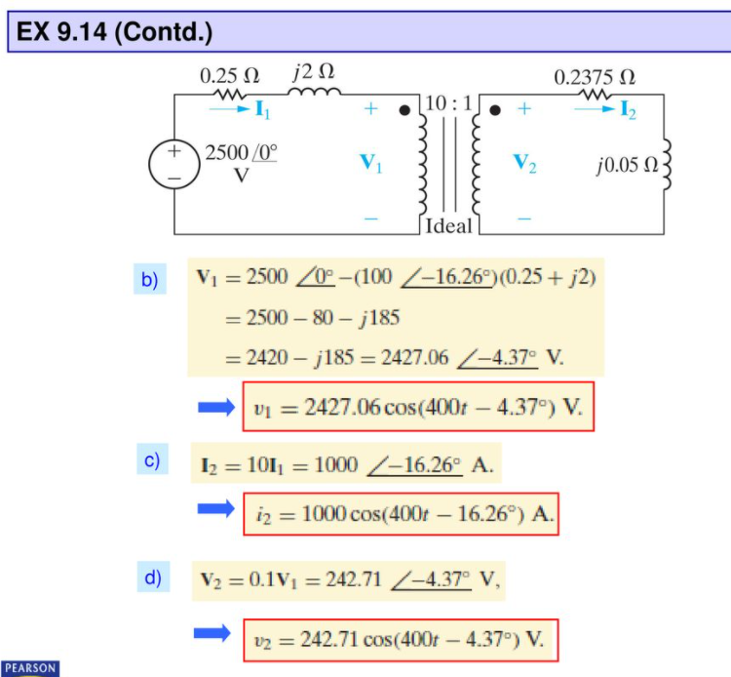

Slide 9
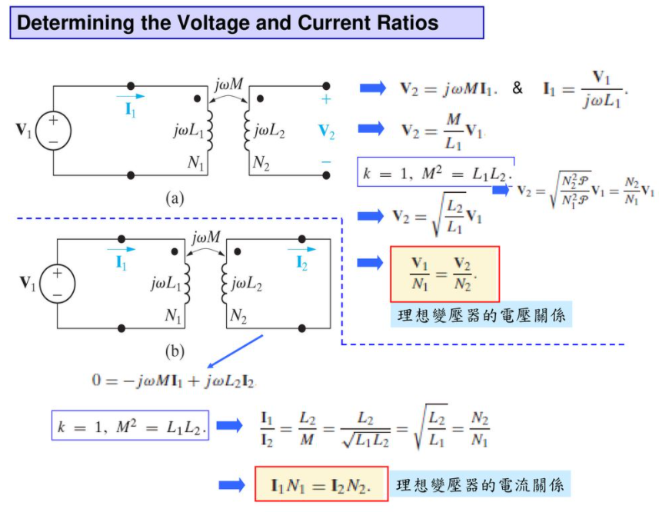

Slide 10

A)
Autotransformer
B)
Isolation Transformer
https://www.youtube.com/watch?v=b2A8xLK_X60
https://www.youtube.com/watch?v=fix47oLcc1s
https://www.youtube.com/watch?v=KrZ7UsSfDms

Slide 11
https://microcontrollerslab.com/power-supply-electronics-projects/
http://education.ema-eda.com/iTrain/PSpice163/PSpice_lesson9.html

Slide 12

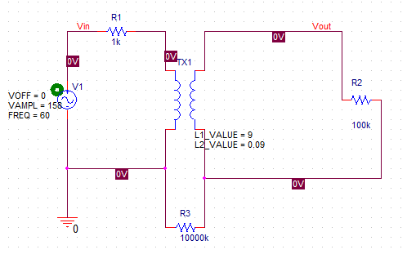
B)
Isolation Transformer
For 降壓
https://techdocs.altium.com/display/AMSE/Transformer+(Equivalent+Circuit+Model)

Slide 13
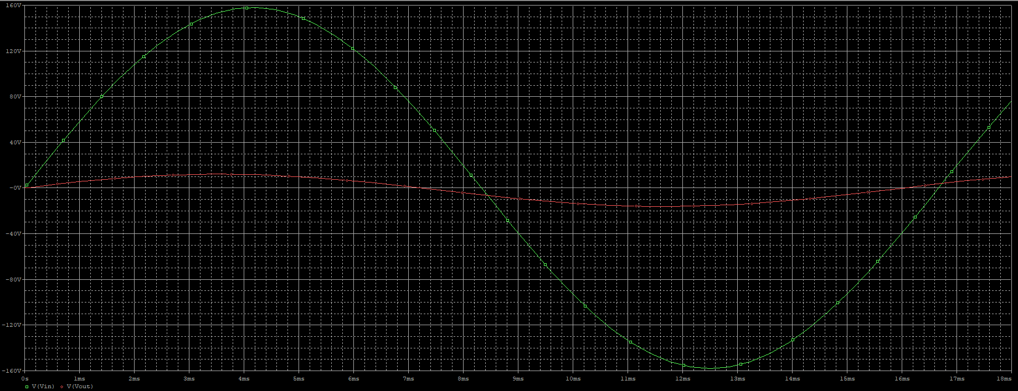

Slide 14
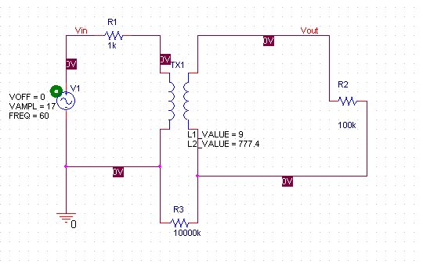
B)
Isolation Transformer
For 升壓

Slide 15
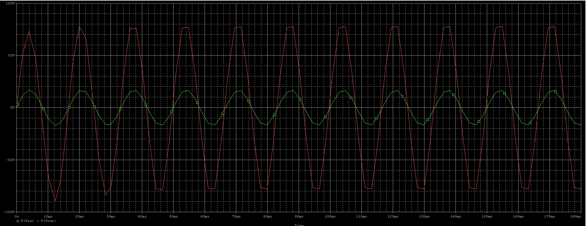

Slide 16
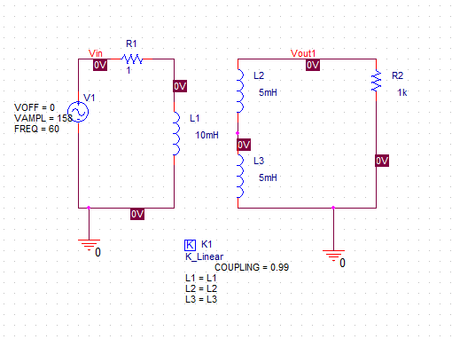
A)
Autotransformer

Slide 17
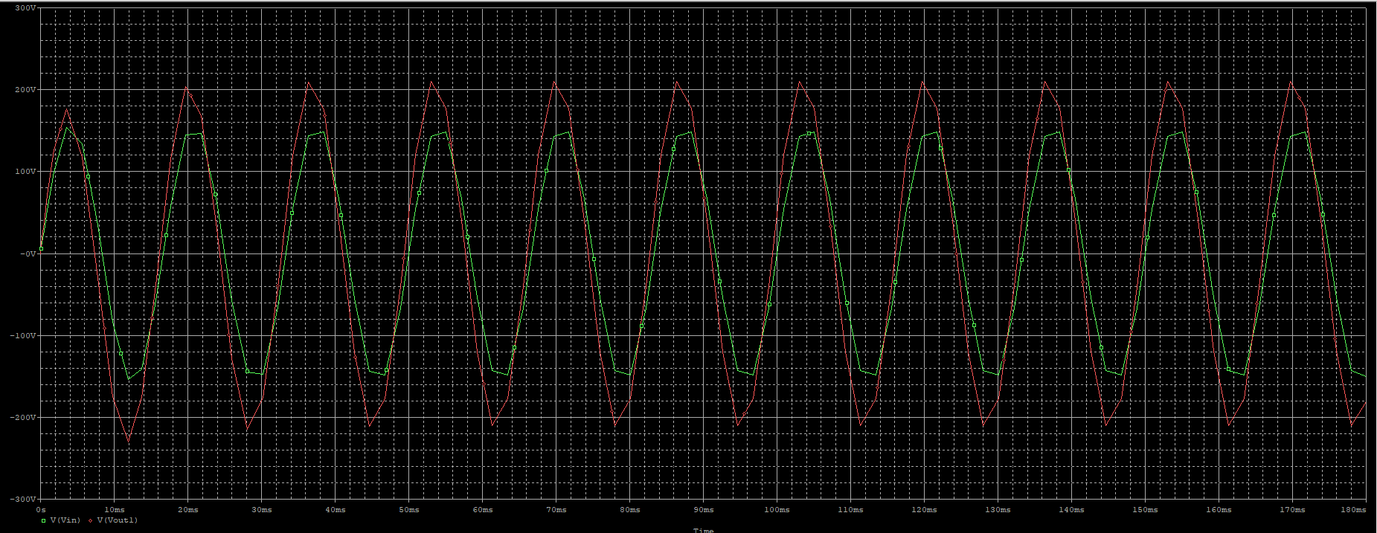

Slide 18
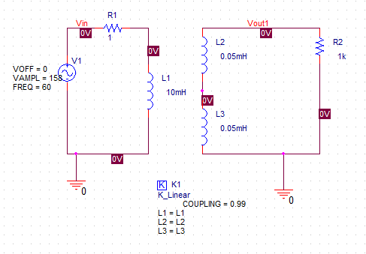

Slide 19
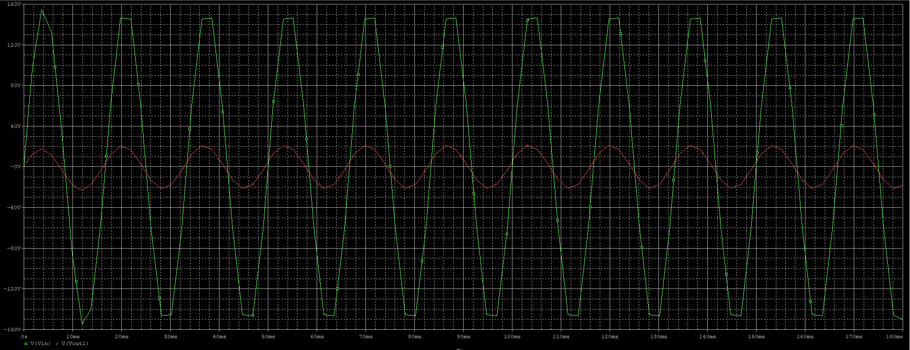

Slide 20
